Slide 1
British Airways
Predictive model and its results
(Random Forest Classifier)
12-09-2023

Slide 2

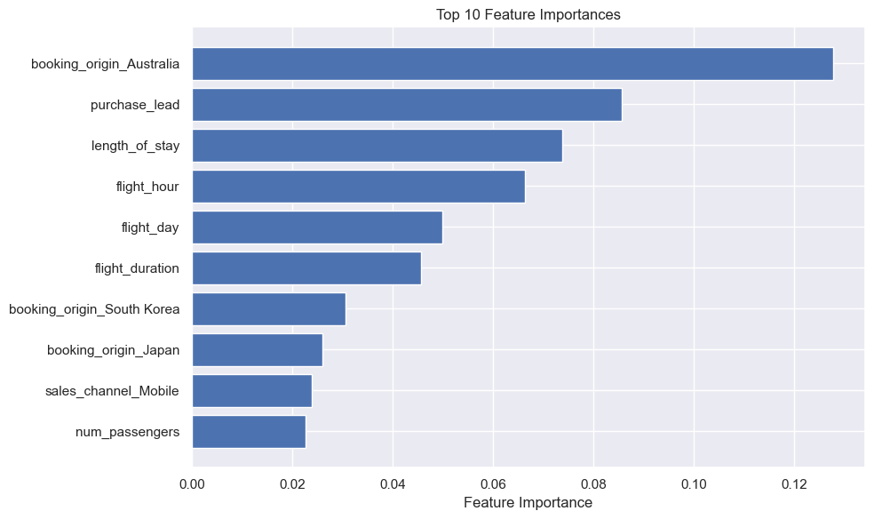
Results
Evaluation:
The data is imbalanced, because majority of customer didn’t complete the booking.
Booking not completed : 85.04%
Booking completed : 14.95%
The results of Modelling if using original data:
Accuracy : 0.8552
Precision : 0.5435
Recall : 0.1351
F1-Score : 0.2165
ROC AUC : 0.5577
After using SMOTE to handle the imbalanced data:
Accuracy : 0.8972
Precision : 0.9124
Recall : 0.8803
F1-Score : 0.8961
ROC AUC : 0.8973
The most important variable value in the model is booking_origin_australia because most of our customer that booking the ticket are from Australia.
Although the model is performing really good after the imbalanced data is handled using SMOTE, but that is not the original data that gotten from customer.

